Slide 1
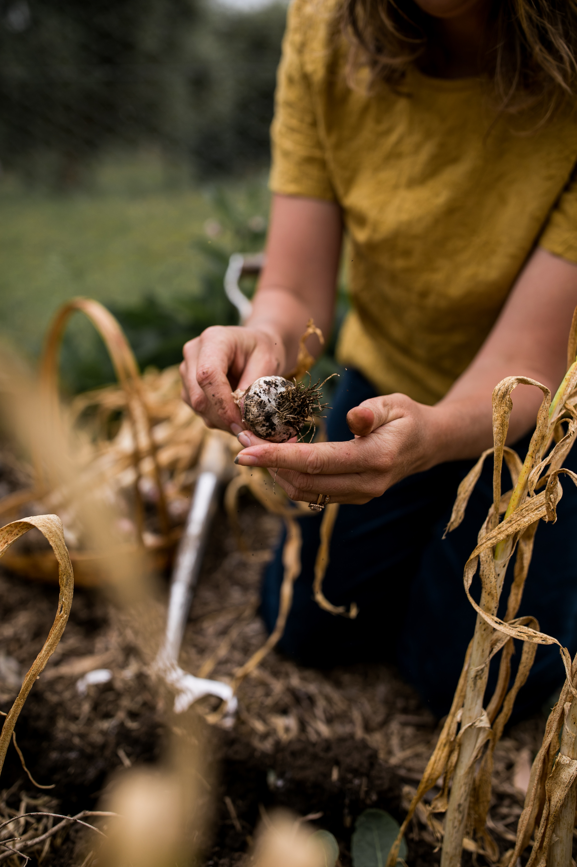
Permaculture practices for the home garden.
Kirsty Williams
Growing Home Permaculture

Slide 2
Ethics of Permaculture
1. EARTH CARE– Rebuild Natural Capital
2. PEOPLE CARE – Looking after self, kin and community.
3. FAIR SHARE – Set limits to consumption and reproduction and redistribute surplus.

Slide 3
Permaculture Design Principles
1. Observe and Interact – ‘Pay attention’
2. Catch and Store Energy – ‘Harvest while it’s abundant’
3. Obtain a Yield – ‘Make sure you’re getting valuable results’

Slide 4
Permaculture Design Principles
4. Use and Value Renewable Resources and Services
5. Produce no Waste

Slide 5
Observation
Noticing without judgement.
Recording your observations.
Takes place over an entire year. Slow and steady.

Slide 6
People Analysis
Wish list for your property
What do you want it to provide?
How much time do we have for our garden?
What do we like to eat?
Are we away from home a lot?
What is my budget – energy, time and financial.

Slide 7
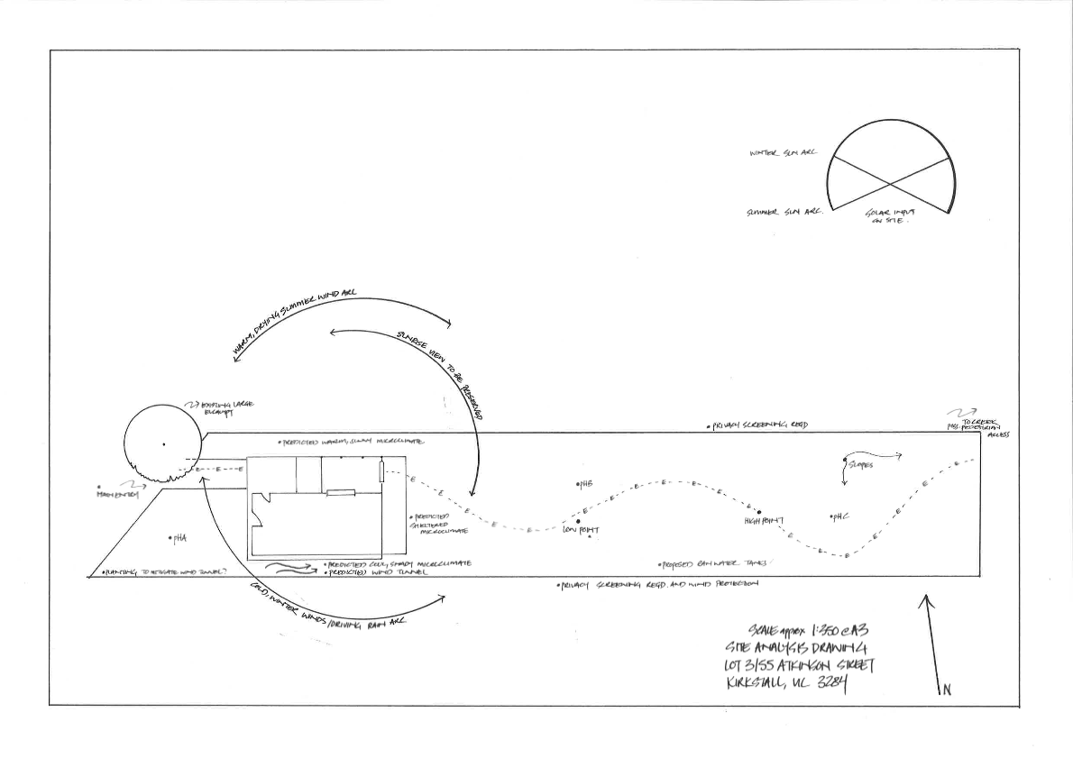
Site Analysis
Climate
Landform
Water
Access and Energy Flows
Existing Trees and Vegetation
Structures
Microclimates
Soil

Slide 8
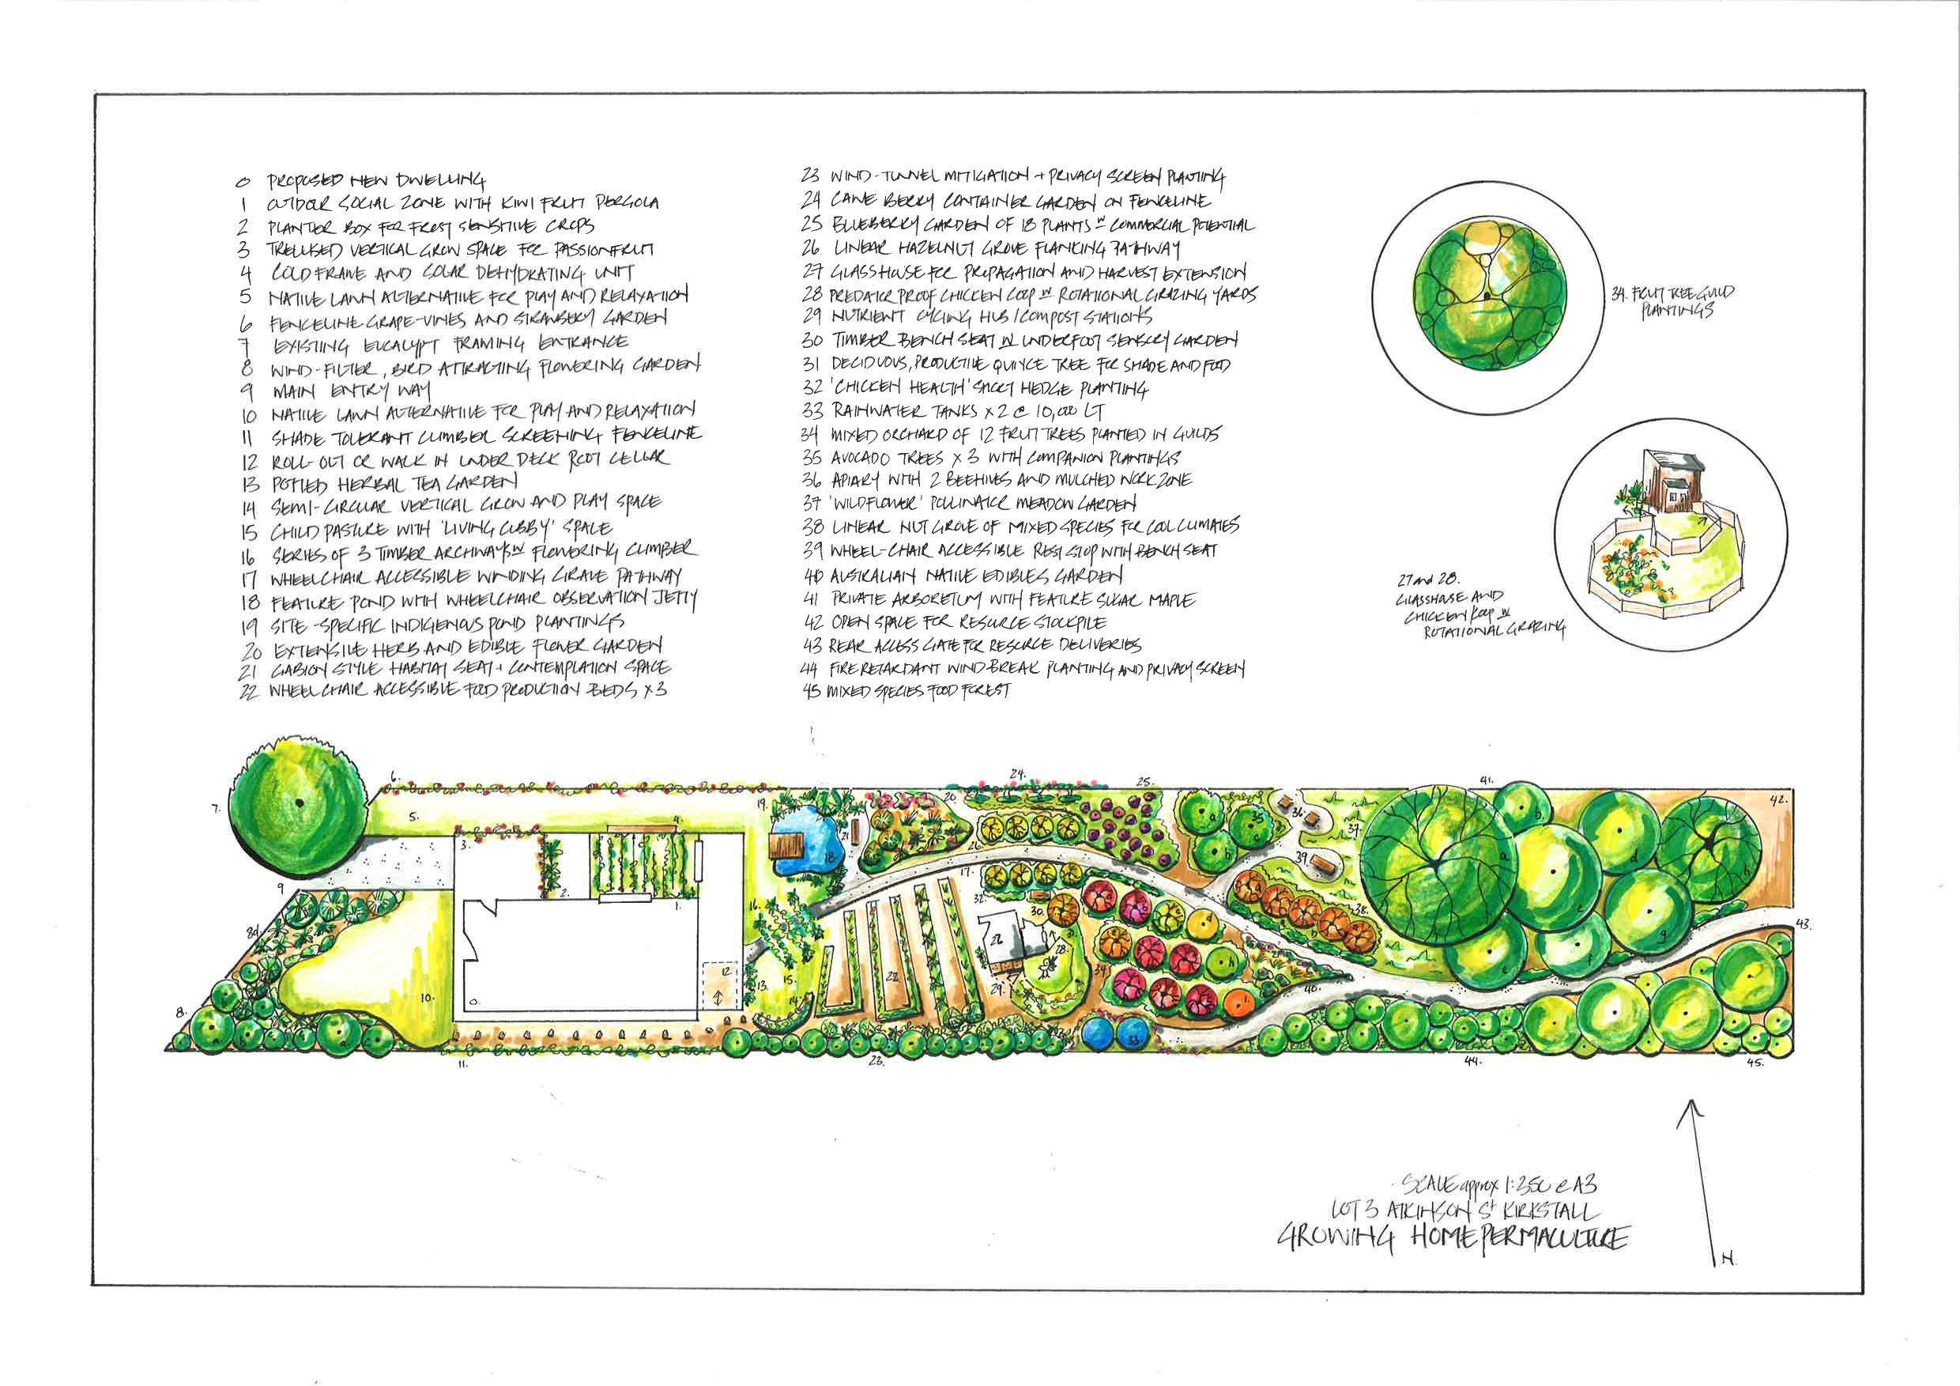
Zone planning and making connections
Group elements with similar needs/products together.
Position elements based on their energy requirements.
Build relationships and stack functions.

Slide 9
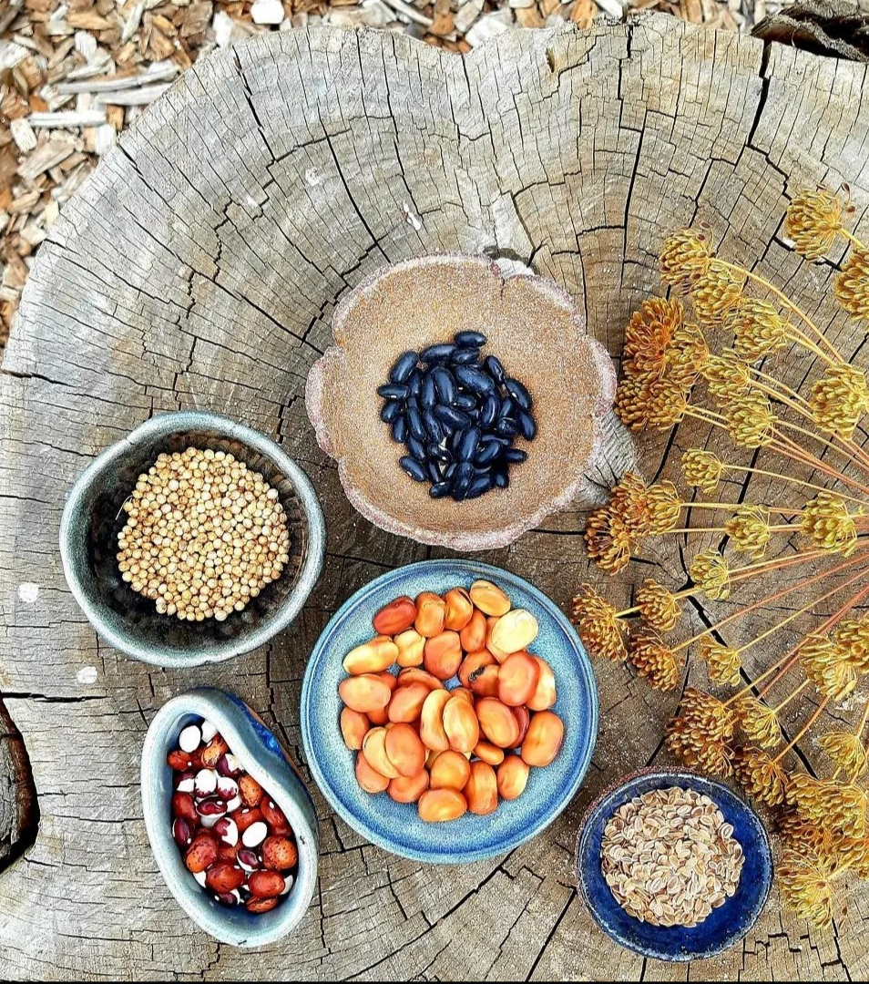
Using permaculture practices to grow your garden
Low or no waste
Organic techniques
Closed loop systems
Prioritizing soil health
High yield, low input food production

Slide 10
Using permaculture practices to grow your garden
Planting for increased biodiversity
Integrated pest management strategies
Investing in new skills
Seed Saving
Food preservation techniques

Slide 11
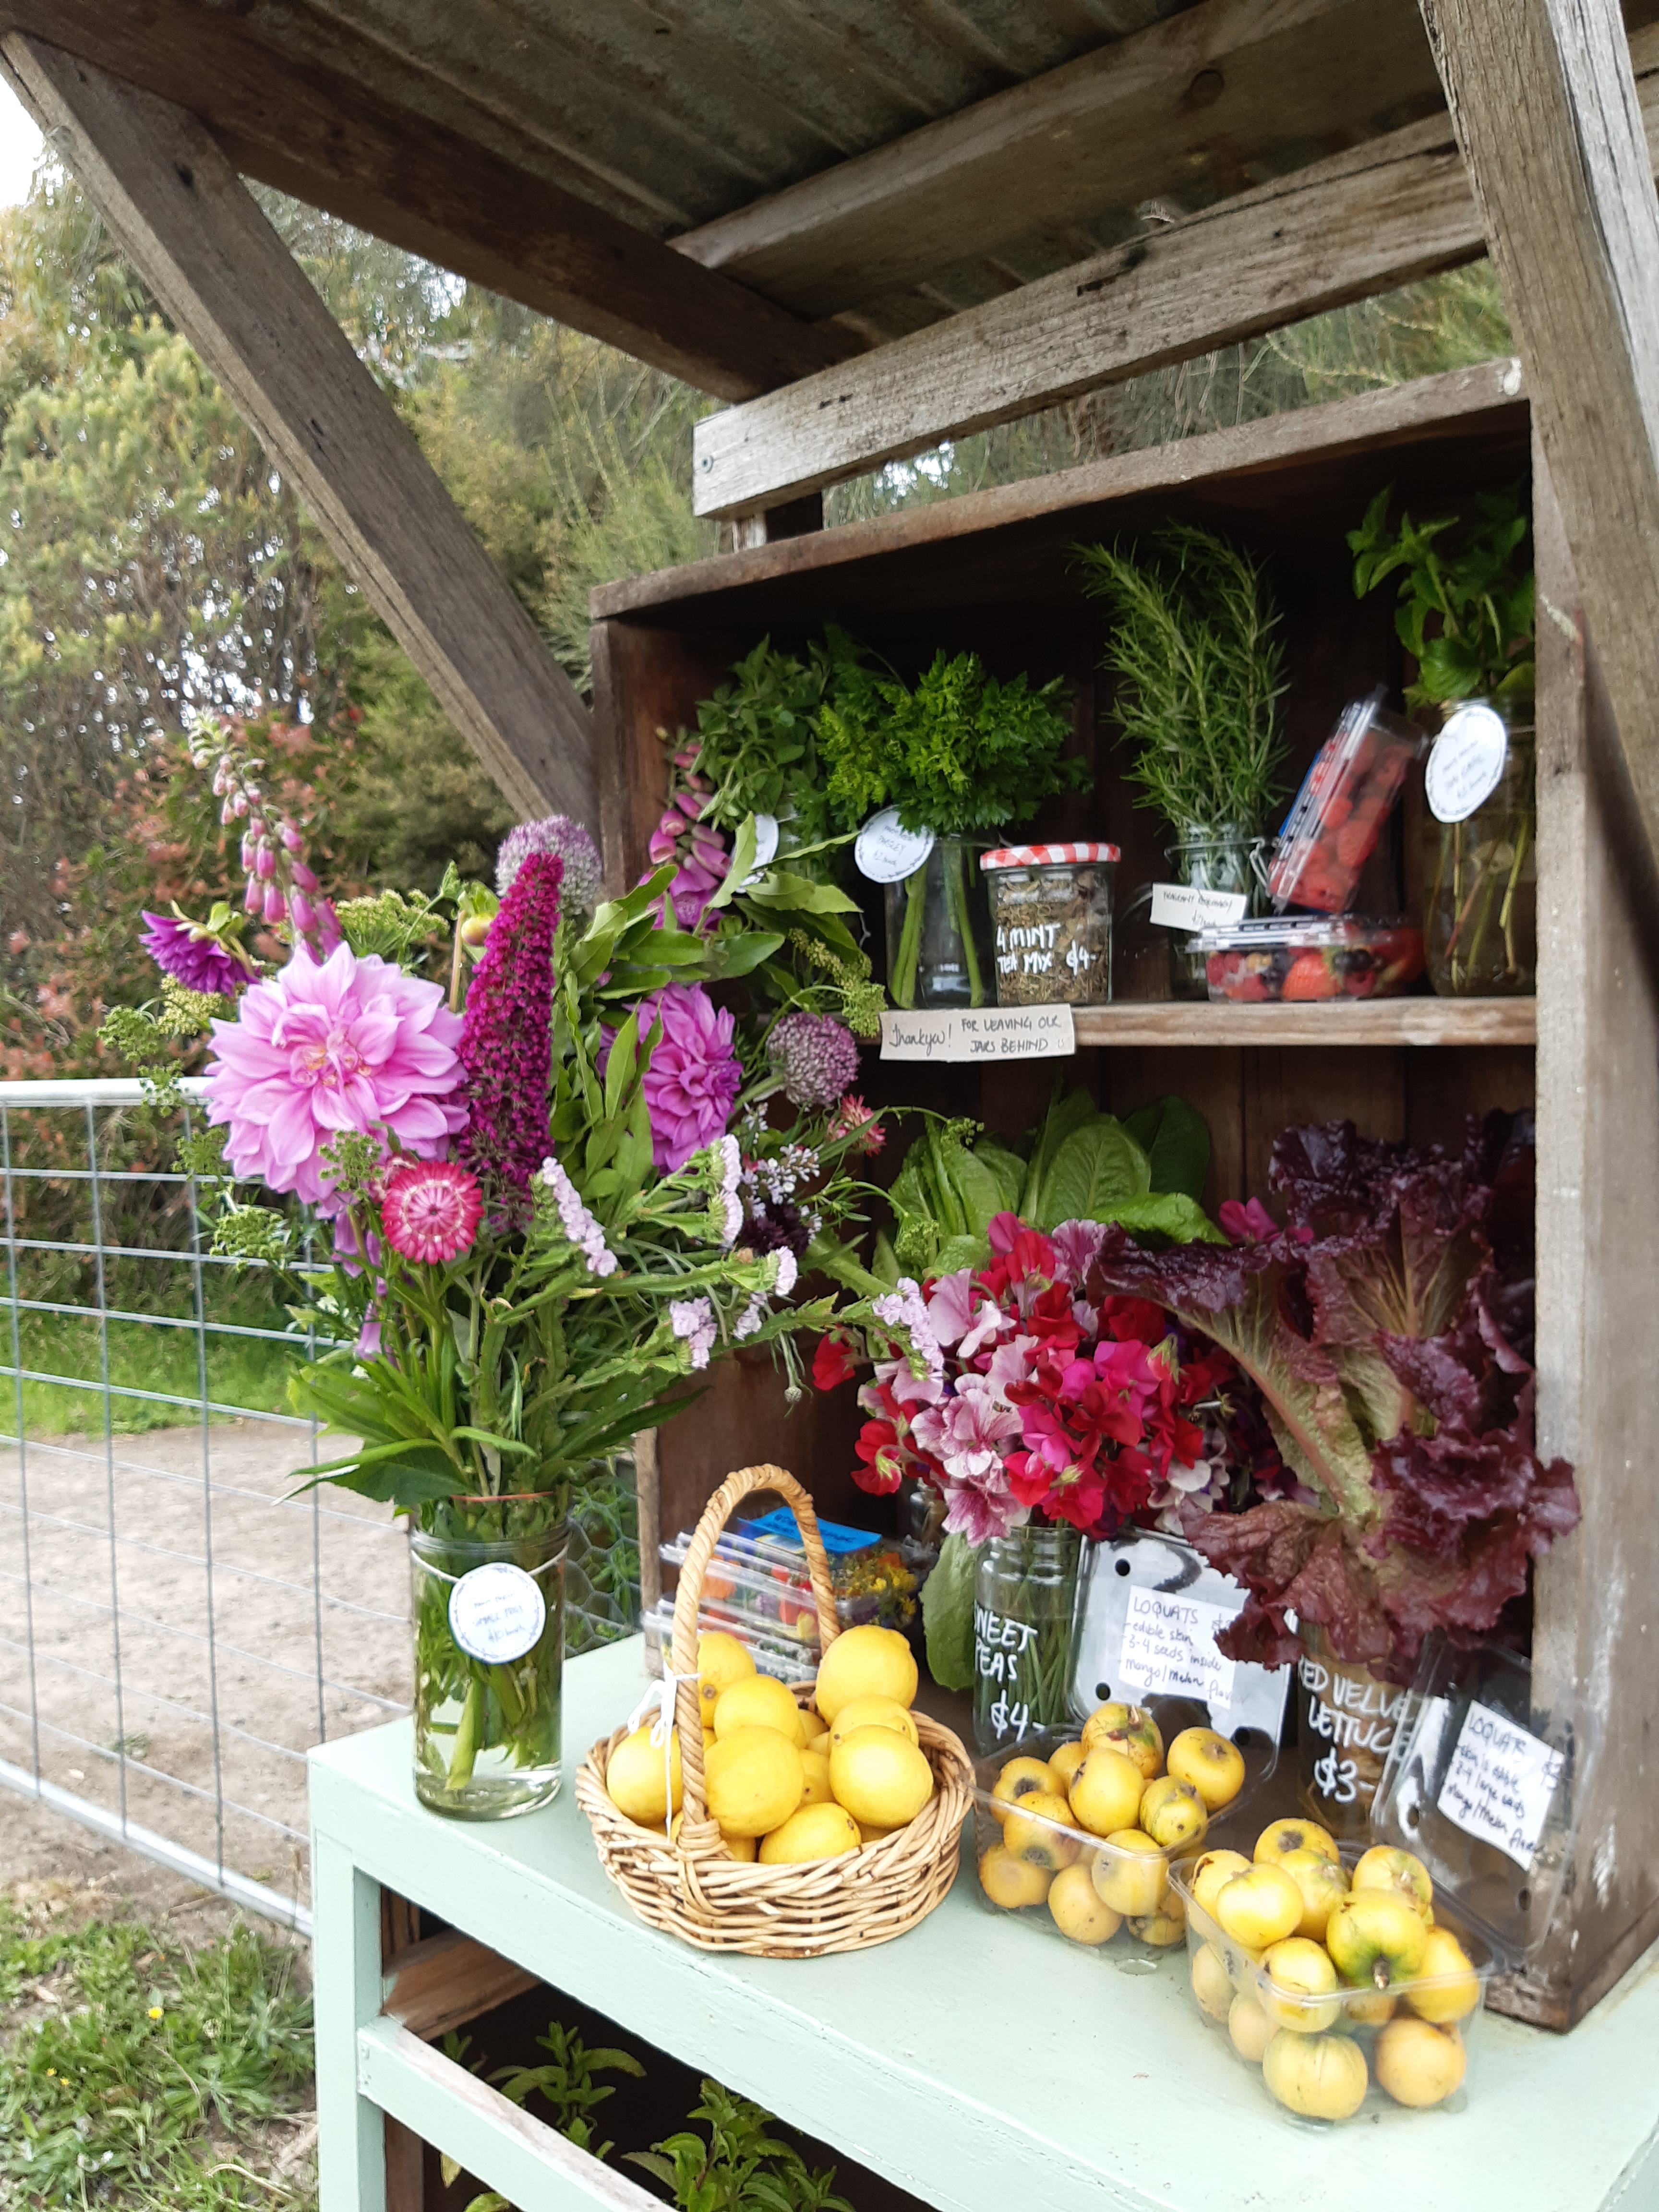
Community Sufficiency
Sharing our harvest
Sharing our skills
Redistributing surplus
Undertake larger community projects

